Slide 1
Lecture 5 Signal Processing Part II

Slide 2


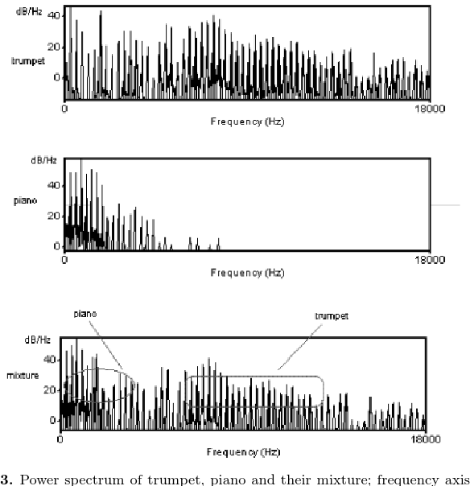
Problem with filters
They can only deal with simple sources of noise
In reality, noise can occupy a wide frequency spectrum, so it is hard to remove only noise without compromising the data only using filters
+
=
Jiang et.al., 2009
Notes:
https://www.dreamstime.com/illustration/male-teacher.html
https://www.istockphoto.com/search/2/image?mediatype=illustration&phrase=piano+player

Slide 3
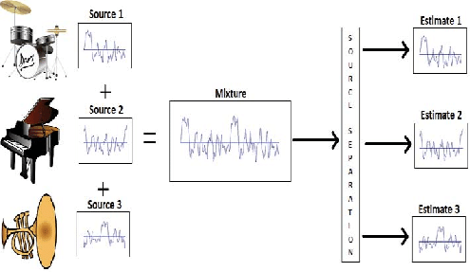
Solution: Blind source separation
Blind source separation is the separation of a set of source signals from a set of mixed signals, without the aid of information about the source signals or the mixing process (Wikipedia)
Independent Component Analysis (ICA) is one of the methods for conducting blind source separation
Notes:
https://www.researchgate.net/figure/Blind-Source-SeparationBSS-Model_fig3_297206976

Slide 4
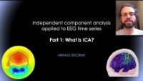

Slide 5


Motivation (example of sound)
After ICA
Sound recorded from Microphone 1
Source 1
Sound recorded from Microphone 2
Source 2
Sound recorded from Microphone 3
Source 3
Notes:
https://blricrex.hypotheses.org/ressources/eeg/little-introduction-to-independent-components-analysis-ica
https://www.dreamstime.com/illustration/black-gift-box.html

Slide 6
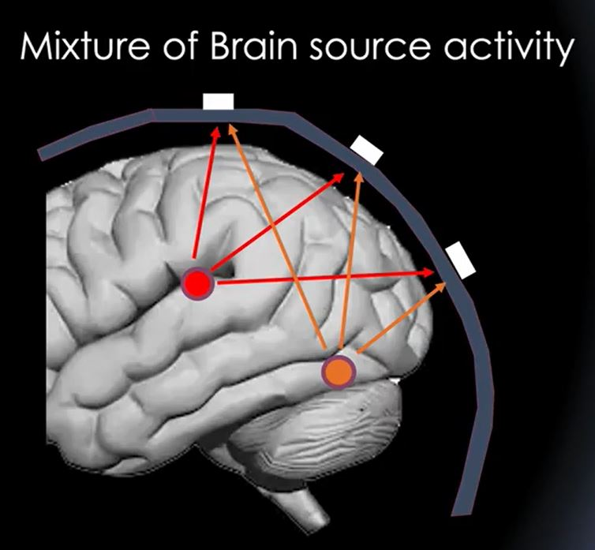
Motivation (brain signals)
In an ideal world, each source represents some activation in that region. But this is not necessarily the case because ICA only decomposes the data into maximally statistically independent sources.
In the ideal case:
represents motor cortex activation
represents visual cortex activation
Notes:
https://www.semanticscholar.org/paper/State-space-model-estimation-of-EEG-time-series-for-Plub-in-Songsiri/f5e1cb0afb1f652ce82b13b820a6f118bc90f95e

Slide 7
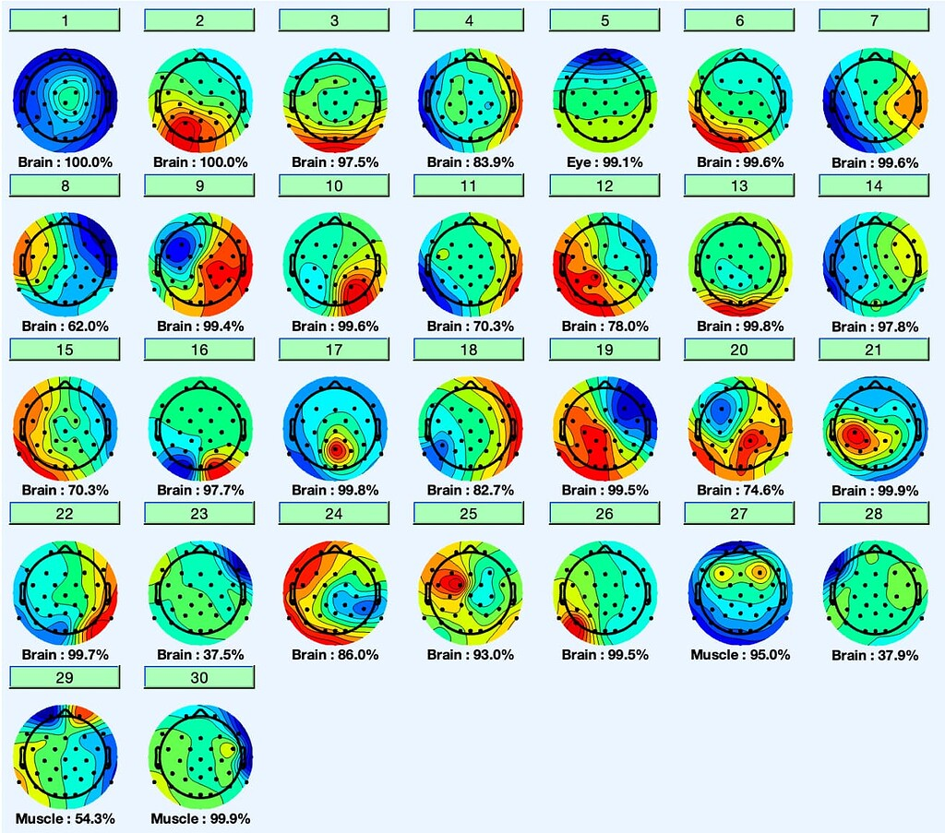
ICA results on real EEG data
By using EEGLab’s automatically IC labeling tool, we can remove those non-cortical ICs, thus cleaning the data
Notes:
https://neuroimage.usc.edu/forums/t/automatic-eeg-ic-ica-classification-for-brainstorm/33785

Slide 8
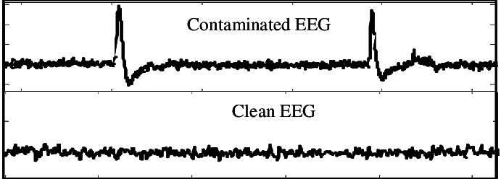
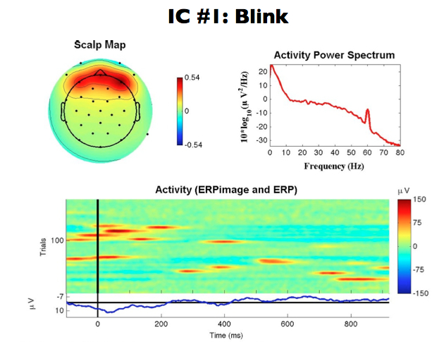
Data before IC removal v.s. Data after IC removal
Notes:
https://www.researchgate.net/figure/A-representative-raw-EEG-signal-FP1-vs-a-clean-EEG-signal-ambulatory-single-channel-EEG_fig1_279198937
https://spikesandwaves.wordpress.com/tag/ica/

Slide 9
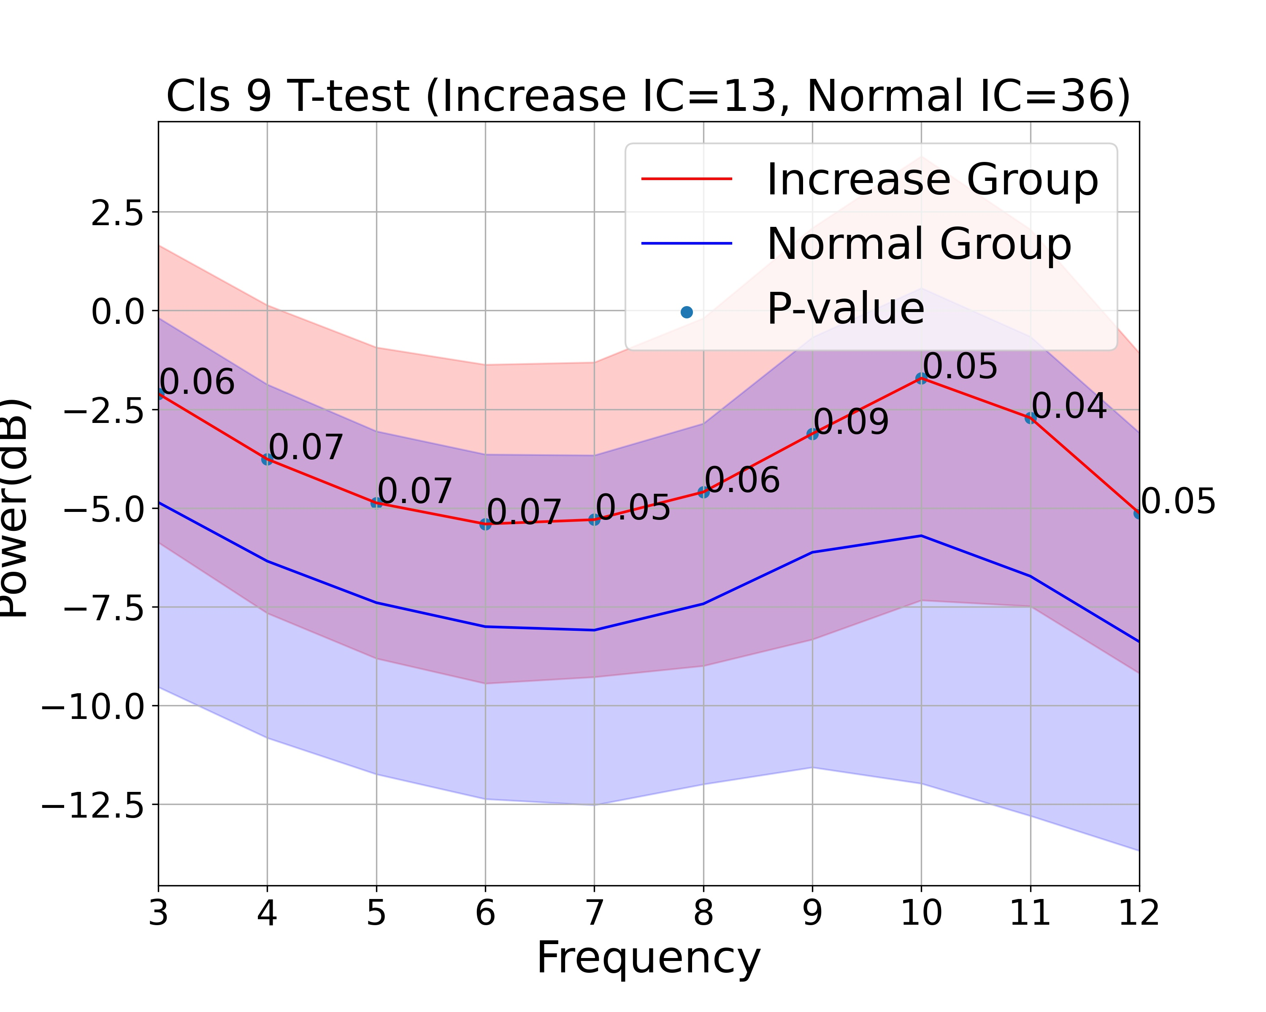
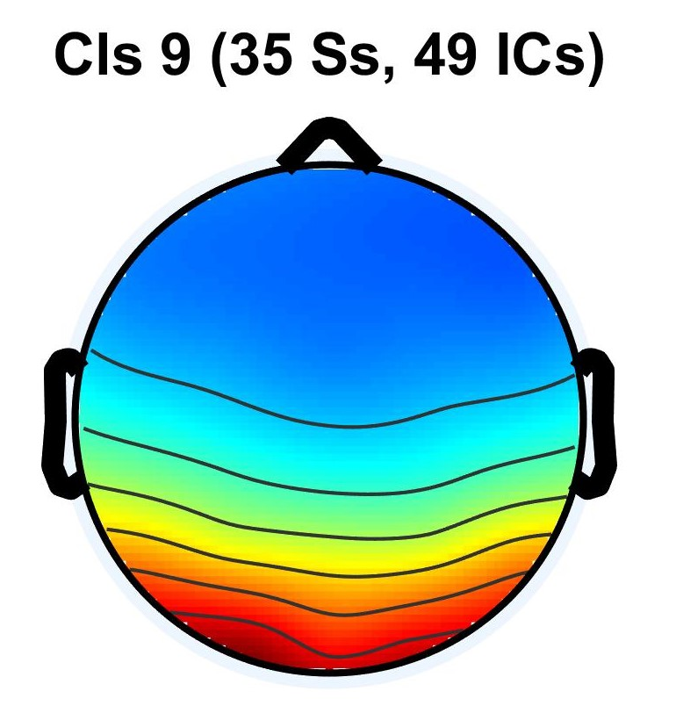
Other ways we could use the ICs
Biomarkers
Same region can have different activation in different brain states (e.g. stress v.s. no stress)
Wang, 2022

